Slide 1
Metastick
Your Gut’s New BFF

Slide 2
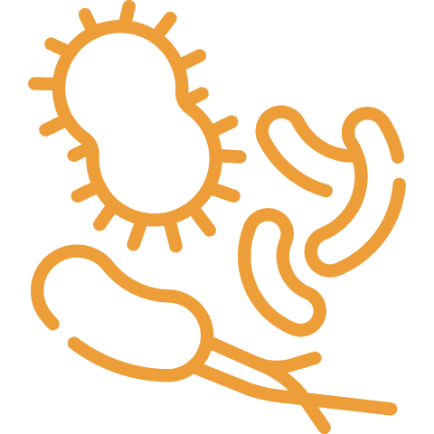
Our well-being, as well as our body functions, depend on our intestinal health. What else do we know about it?
It is the largest organ by mass (the length of an adult’s intestines is about 25 feet long*)
It supports your immunity (70% of immune cells are found in the gut.***)
It influences your mood (90% of 5-HTP, one of the building blocks or precursors for serotonin, the happiness hormone, is produced in the gut**)
It contains most of the body's microflora (0.3% of body weight***)
*https://www.ncbi.nlm.nih.gov/pmc/articles/PMC1981305/pdf/brmedj03234-0035.pdf
**https://www.cell.com/cell/fulltext/S0092-8674(15)00248-2
***https://www.hopkinsmedicine.org/research/advancements-in-research/fundamentals/in-depth/the-gut-where-bacteria-and-immune-system-meet
****https://journals.plos.org/plosbiology/article?id=10.1371/journal.pbio.1002533

Slide 3
What we know about Microflora
Each person’s is unique, like fingerprints. Even the microflora of identical twins, with the same genotype, is only about 20% similar*
There are about 38 trillion microorganisms, which is 8 trillion more than the number of cells in the body**.
It plays a role in synthesizing B-group vitamins
Its ability to provide protection diminishes with age
* https://www.sciencenews.org/article/identical-twins-may-not-be-so-identical-when-it-comes-gut-bacteria
** https://journals.plos.org/plosbiology/article?id=10.1371/journal.pbio.1002533
Notes:
Protects us from Premature aging

Slide 4
Microfloral imbalance in the gut manifests itself in these ways:
Problems with stool
Intestinal discomfort
Deteriorating skin condition

Slide 5
Over 2 million people in the US suffer from an imbalanced microflora
Your body is full of colonies of harmless bacteria known as microbiota. Most of these bacteria have a positive effect on your health and contribute to your body’s natural processes.
But when one of these bacterial colonies is out of balance, it can lead to dysbiosis causing:
flatulence
bloating
abdominal pain
diarrhea
constipation
weaker immunity
emotional instability
premature aging
https://www.ncbi.nlm.nih.gov/pmc/articles/PMC4838534/
https://atlasbiomed.com/blog/what-is-dysbiosis/
https://www.webmd.com/digestive-disorders/what-is-dysbiosis

Slide 6
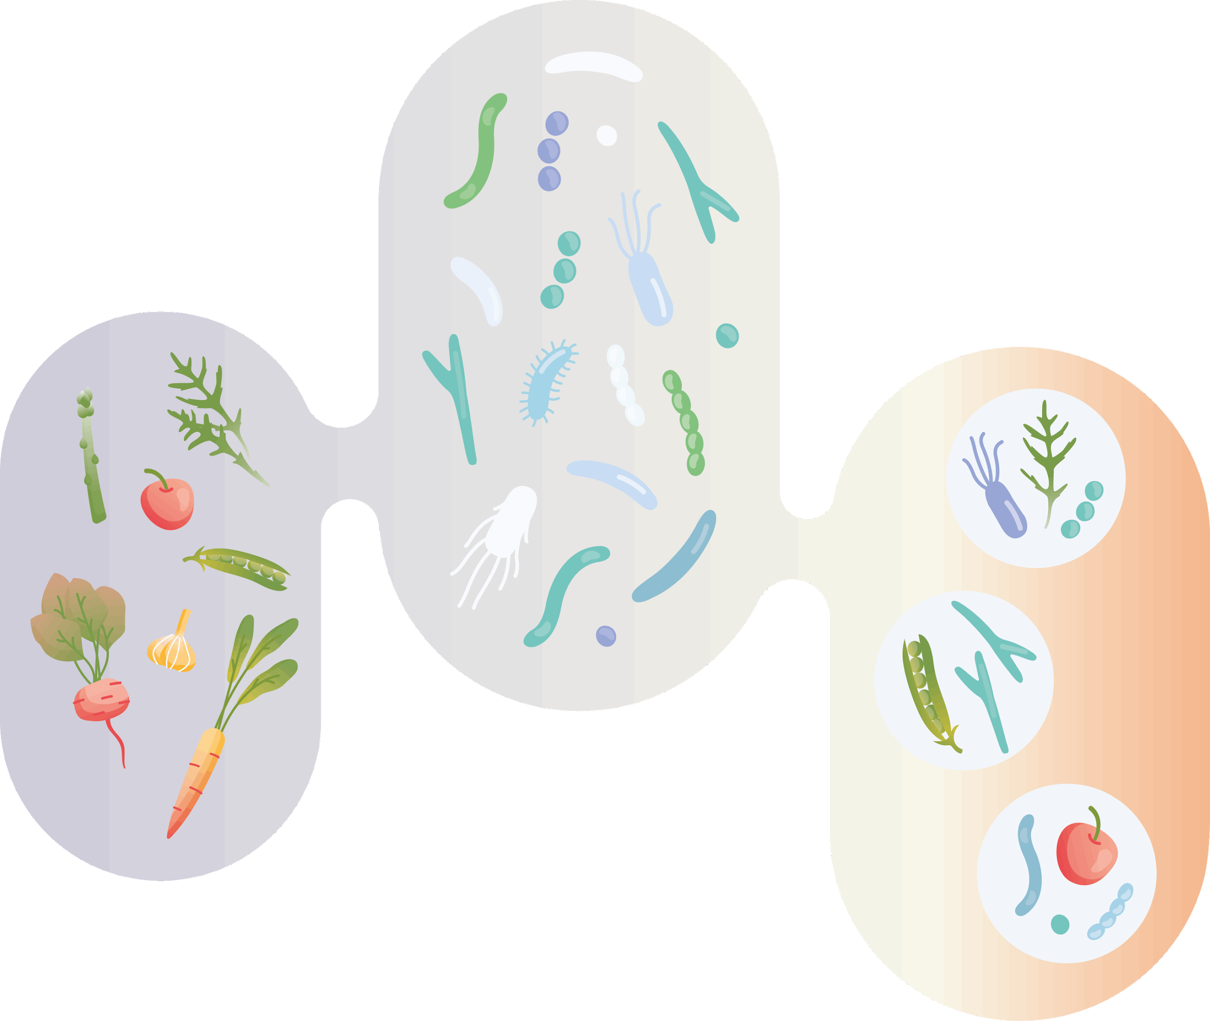
How we usually take care of our intestinal Microflora
Probiotics Living microorganisms, when applied in adequate amounts, improve health.
Synbiotics The combination of probiotics and prebiotics.
Prebiotics Non-digestible substances that are essentially food for probiotics.

Slide 7
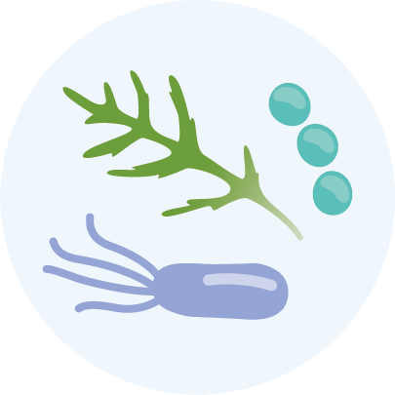
What happens when you use
probiotics?
The living probiotic microorganisms (lacto- and bifidobacteria) secrete certain useful organic acids, vitamins and substances with antibacterial properties.
The combination of these substances is called metabiotics (active metabolites); they have biological activity and can take part in the biochemical process, thereby improving the probiotics environment.

Slide 8
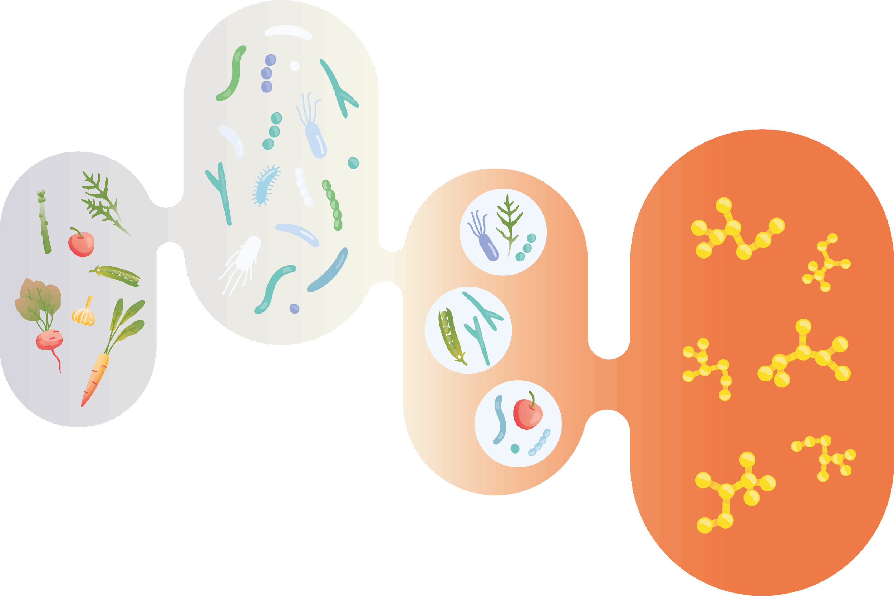
A new generation of products
to take care of intestinal microflora
Prebiotics
Metabiotics (postbiotics) are structural components of probiotics or products of their metabolism, which have biological activity and optimize the growth of our own intestinal microflora.
Probiotics

Slide 9
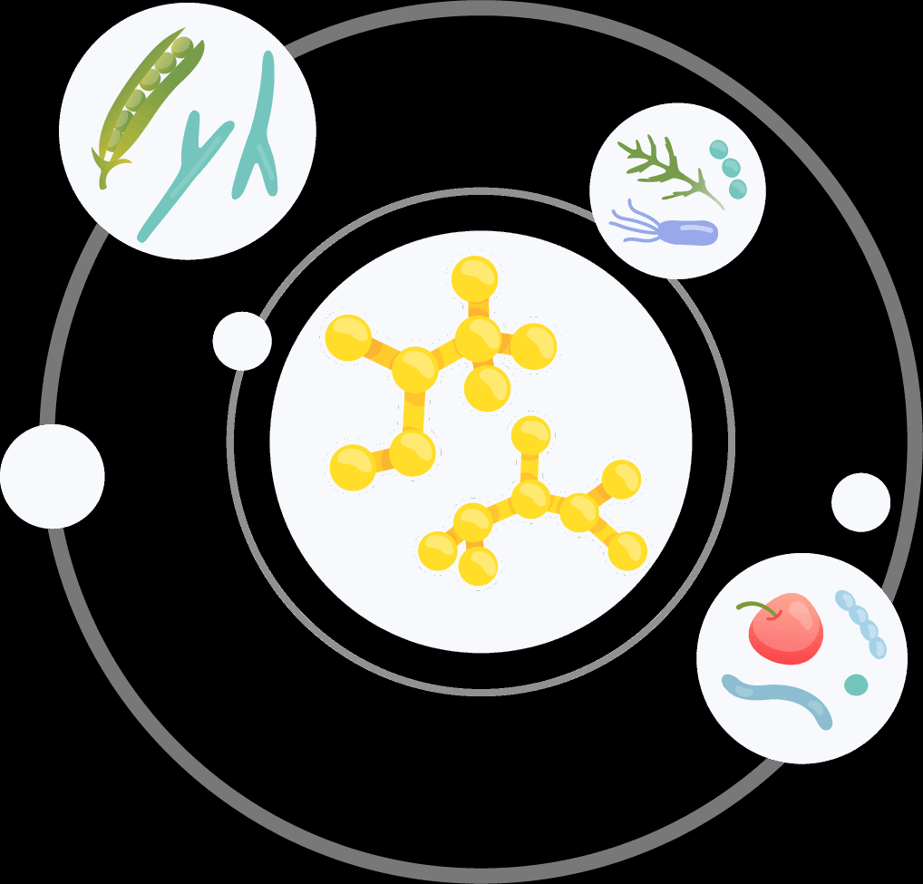
Metabiotics
A new generation of products to take care of our intestinal microflora
Take effect immediately
Activate natural healthy microflora growth
Don’t conflict with the body's microbiota and is highly digestible
Tolerant to acidic environments and antibiotics
Long shelf life
Notes:
Metabiotics contain ready-to-use active metabolites of known representatives of the natural microflora. Once in the gut, they take effect immediately, requiring no time to activate. Metabiotics, being products of metabolism rather than living organisms, are not destroyed by gastric juices, digestive enzymes and are not damaged by antibiotics.

Slide 10
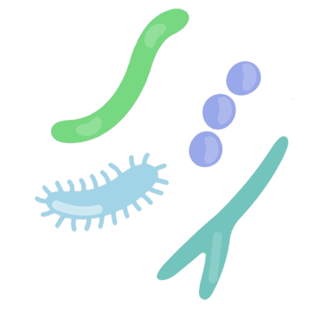
Taking care of your Gut Microflora: What's the difference between pro- and meta- biotics?
They act synergistically,
restoring intestinal microflora
Metabiotics
Probiotics
Do not contain live microorganisms
Activate the growth of your own microflora
Resistant to acidic digestive juices
Do not require special storage conditions
Can be taken in conjunction with antibiotics
Living microorganisms
Improve the qualitative composition of microflora
Sensitive to acidic digestive juices and damaged by antibiotics
Often require strict storage conditions

Slide 11
Recommendations for taking probiotics, metabiotics or a combination, dependents on the goal:
Probiotics
Metabiotics
Improves skin condition
Stool normalization
Helps with appetite control
Reduces allergic reactions
Strengthens one’s immunity
During the reception of antibiotics
Helps put you in a better mood

Slide 12
At Coral Club, we focus on gut health and create solutions inspired by nature and based on scientific research

Slide 13
Metastick
restoring your native
microflora
This statement has not been evaluated by the Food and Drug Administration. This product is not intended to diagnose, treat, cure, or prevent any disease

Slide 14
Metastick acts immediately right after ingestion
01
The components of this metabiotic pass through the aggressive environment of the stomach and enter the intestines unaltered and unharmed
02
The synergistic action of the ingredients activates the growth of your body’s own microflora
This statement has not been evaluated by the Food and Drug Administration. This product is not intended to diagnose, treat, cure, or prevent any disease
Notes:
* Metastick ingredients: aqueous substrate of Lactobacillus plantarum metabolites from orange peel, aqueous substrate of Lactobacillus plantarum metabolites from Korean kimchi, vermented banana peel extract, vitamin B6

Slide 15
Metastick's active ingredients help restore your body’s native intestinal microflora
This statement has not been evaluated by the Food and Drug Administration. This product is not intended to diagnose, treat, cure, or prevent any disease

Slide 16
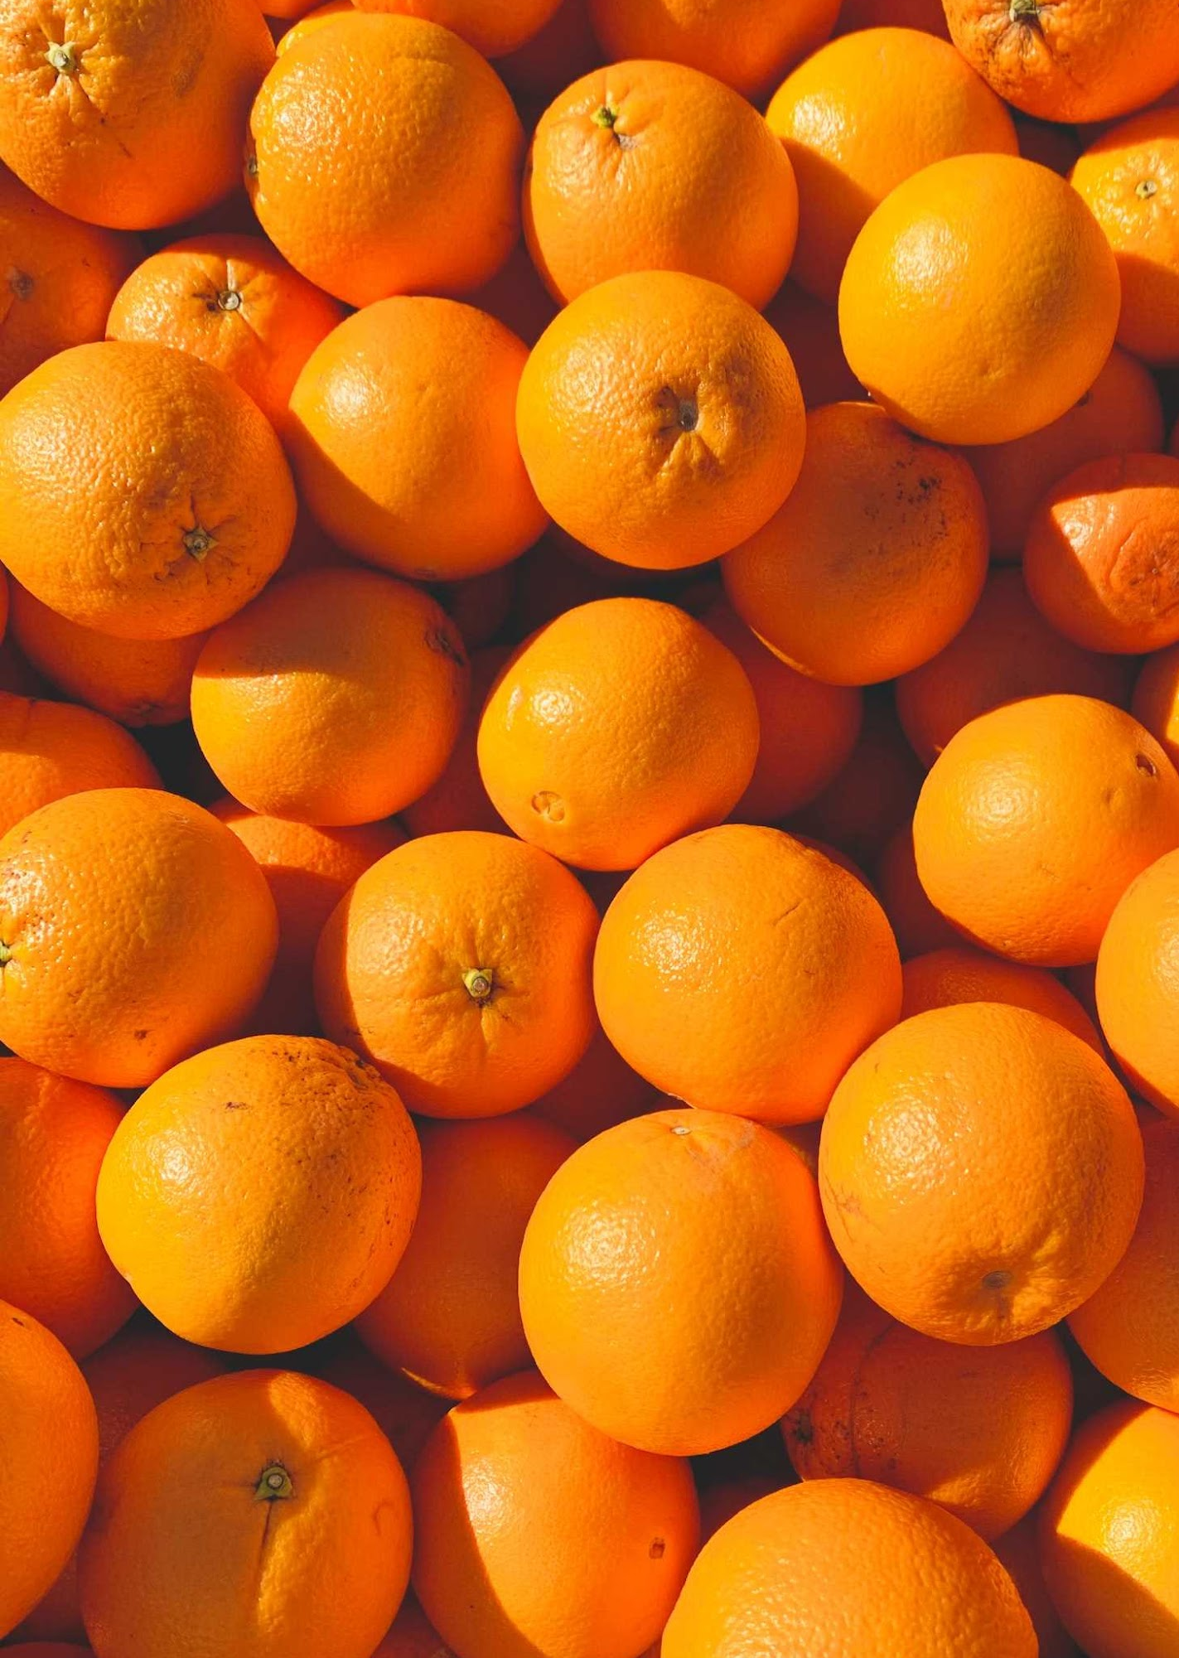
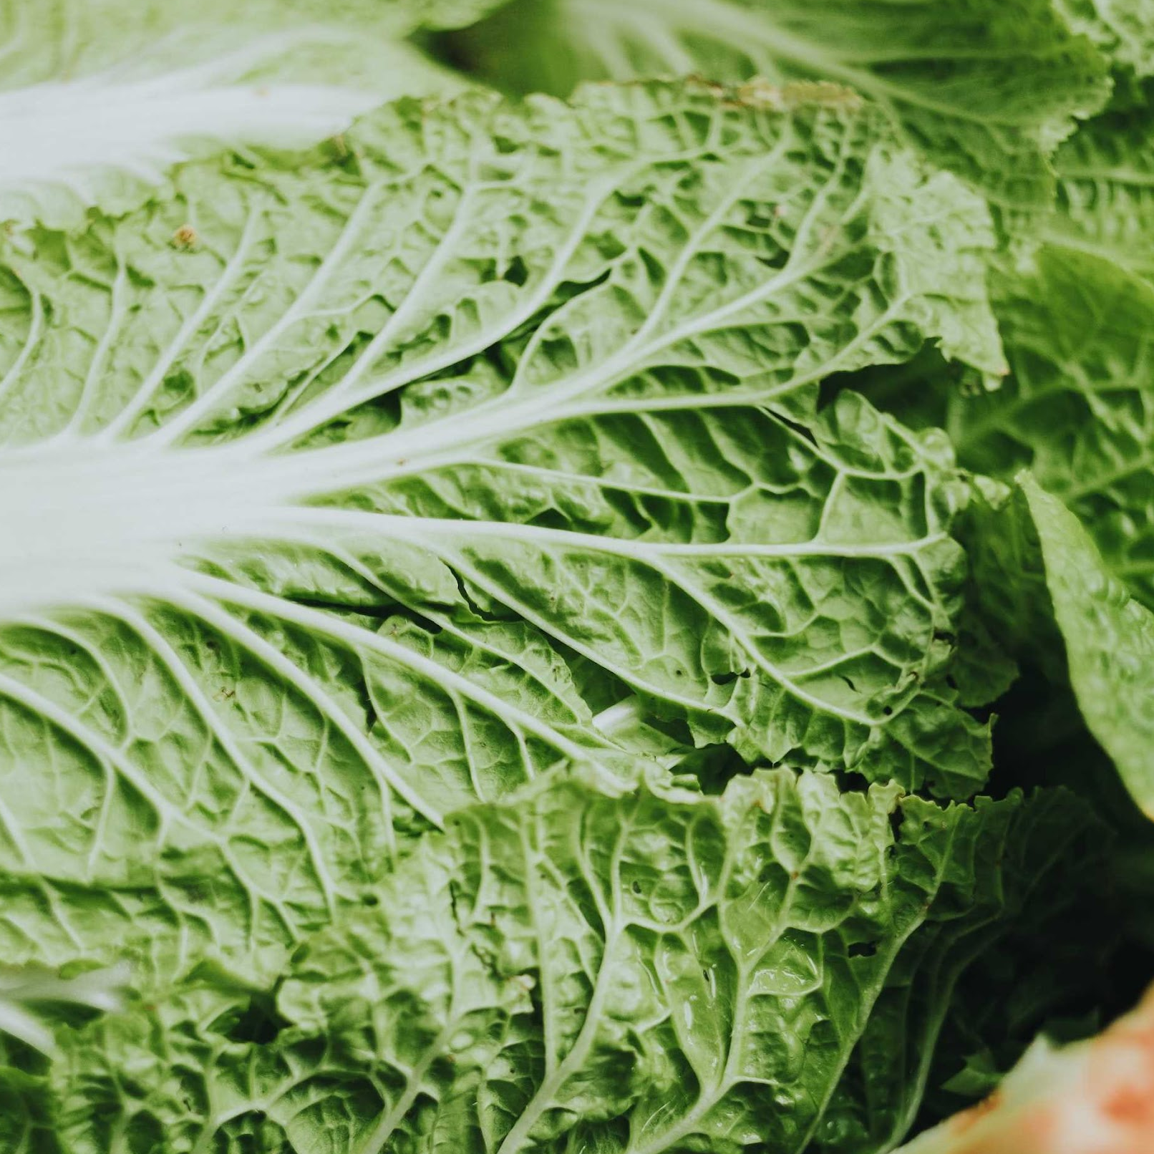
Liquid substrates* of Lactobacillus Plantarum metabolites from orange peel extracts and Korean kimchi cabbage
Traditional Southeast Asian foods, orange and kimchi, are useful "foods" for probiotics, which release a variety of different metabolites thanks to these nutritions.
So, orange and kimchi were chosen as a substrate for Lactobacillus plantarus.
*A substrate is a nutrient medium for the growth and development of living microorganisms
Huang, C.-H., Ho, C.-Y., Chen, C.-T., Hsu, H.-F., & Lin, Y.-H. (2019, December). Probiotic BSH activity and anti-obesity potential of lactobacillus plantarum strain TCI378 isolated from Korean kimchi. Preventive nutrition and food science. Retrieved November 16, 2022, from https://www.ncbi.nlm.nih.gov/pmc/articles/PMC6941724/
Notes:
Probiotic cultures are placed in a nutrient medium, their colony grows and multiplies, releasing waste products and metabolites. The liquid is then centrifuged to separate these products from the probiotic culture. The liquid remaining after the probiotic culture is precipitated during the centrifugation process is called the supernatant.
Metastick contains Lactobacillus plantarum supernatant from orange peel and Lactobacillus plantarum supernatant from Korean kimchi.

Slide 17
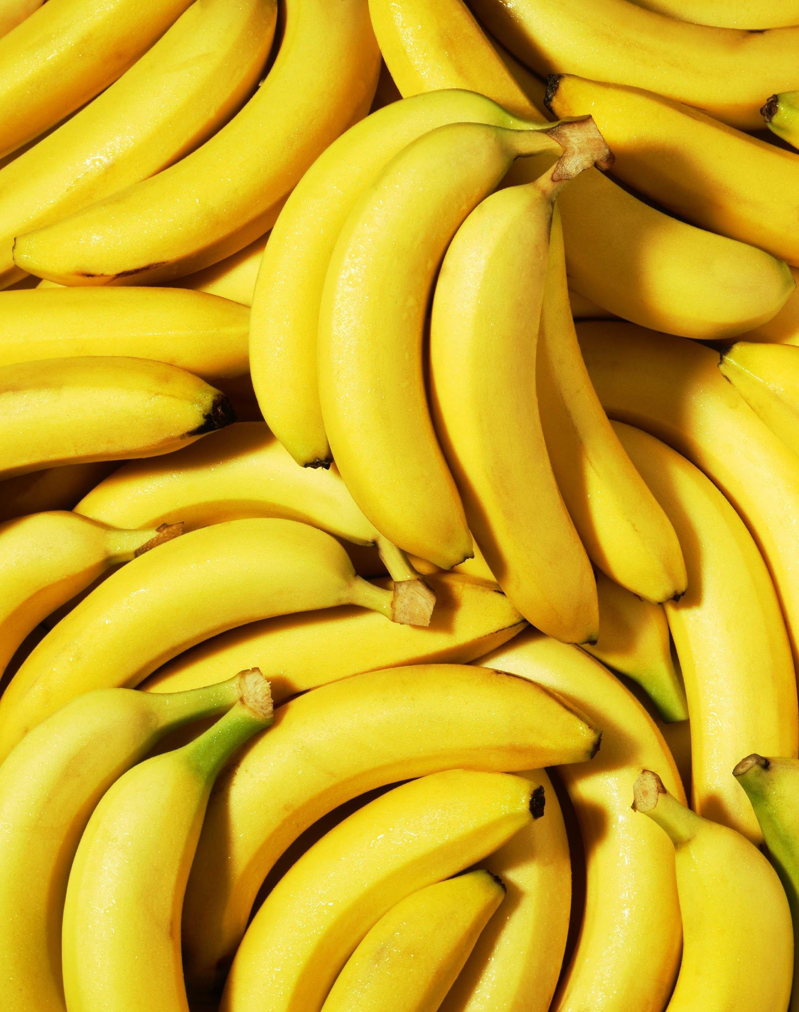
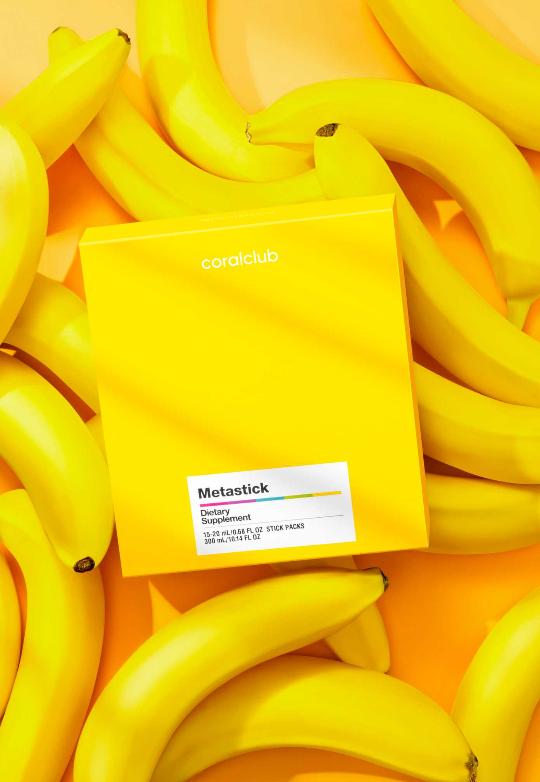
Banana peel extract
Contains fructooligosaccharides, soluble fiber and organic acids.
Fructooligosaccharides and soluble fiber are food for the intestine's own healthy bacteria and help increase their activity, activate intestinal peristalsis, and support lipid and carbohydrate metabolism.
This statement has not been evaluated by the Food and Drug Administration. This product is not intended to diagnose, treat, cure, or prevent any disease

Slide 18
Vitamin В6
This vitamin is partially synthesized in the intestines and is absorbed from food. When microbiota deteriorate, these processes are negatively affected, and can result in substance deficiency.
Vitamin B6 regulates the work of digestive enzymes and is also necessary for:
A proper functioning liver
Absorbing vitamin B12
Your nervous and cardiovascular systems
В6

Slide 19
Futuristic Production Process
Metastick is manufactured in TCI Co., Ltd.'s unique, high-tech manufacturing facility with minimal carbon footprint
Next-generation technology park
Innovative developments
Energy-efficient, environmentally friendly production process
Notes:
New generation technology park
TCI has built 12 laboratories for its RND team of today's 300 researchers with master's and doctoral degrees to develop exclusive proprietary raw materials and products and ensure product safety and potency through genetic tests, in-vivo studies, efficacy tests and clinical trials.
Innovative developments
In the field of plant stem cell development and implementation of an intelligent genetic biodata analysis platform.
Energy efficient and environmentally friendly production
More than 65% of the energy consumed by production is renewable solar energy. TCI is part of the Re100 global initiative, which aims to use 100% renewable energy sources. The company has also pledged to switch completely to renewable energy by 2030.

Slide 20
Quality control
Production:
Meets strict international standards and is GMP, ISO, HACCP certified
Holds over 2400 international patents and 370 international innovation awards
Notes:
Quality and safety
TCI has established 7 internationally certified factories around the world to ensure high quality production.
The company grows raw materials in Sunrise Park, a clean corner in southeastern Taiwan, to provide customers with exclusive products. Raw materials and finished products are tested in an ISO17025 certified laboratory.

Slide 21
Metastick:
Your Gut’s New BFF
Convenient and easy to use
Tightly sealed package (offers protection
against contamination)
Accurate dosage in every stick
This statement has not been evaluated by the Food and Drug Administration. This product is not intended to diagnose, treat, cure, or prevent any disease
Notes:
New generation technology park
TCI has built 12 laboratories for its RND team of today's 300 researchers with master's and doctoral degrees to develop exclusive proprietary raw materials and products and ensure product safety and potency through genetic tests, in-vivo studies, efficacy tests and clinical trials.
Innovative developments
In the field of plant stem cell development and implementation of an intelligent genetic biodata analysis platform.
Energy efficient and environmentally friendly production
More than 65% of the energy consumed by production is renewable solar energy. TCI is part of the Re100 initiative, which aims to use 100% renewable energy sources. The company has also pledged to switch completely to renewable energy by 2030.

Slide 22
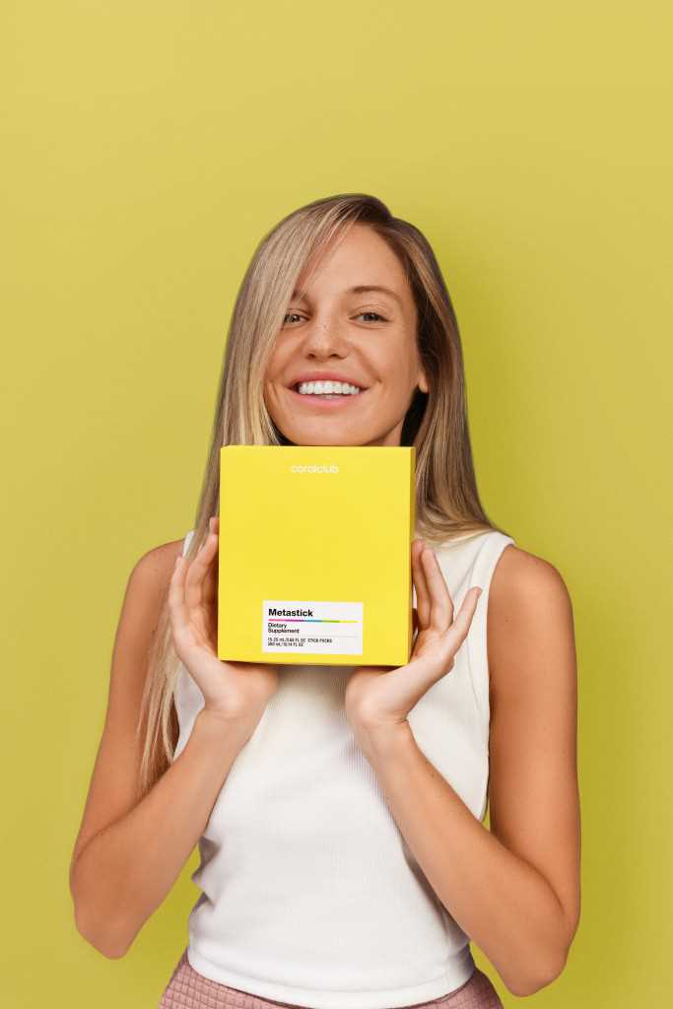
How to use Metastick
Mix the contents of the stick (sachet) with ½ cup (100 ml) of water or juice. Take 1-2 times a day for 15 days before meals.
+
x2

Slide 23
Metastick will help:
Maintain a balanced intestinal microflora
Support digestion and nutrient absorption
Hinder gastrointestinal discomfort and normalize stool
Promote a healthier metabolism
Boost your immune system
This statement has not been evaluated by the Food and Drug Administration. This product is not intended to diagnose, treat, cure, or prevent any disease

Slide 24
Metastick is for those who:
Aren’t following a healthy diet most of the time
Need to improve their eating habits
Experience too much stress
Smoke
Occasionally drink too much alcohol
Want to have better appetite control
This statement has not been evaluated by the Food and Drug Administration. This product is not intended to diagnose, treat, cure, or prevent any disease

Slide 25
Metastick
Helps restore healthy intestinal microflora
Has an immediate effect
Is produced using innovative technologies
Has proven effects on health
This statement has not been evaluated by the Food and Drug Administration. This product is not intended to diagnose, treat, cure, or prevent any disease

Slide 26
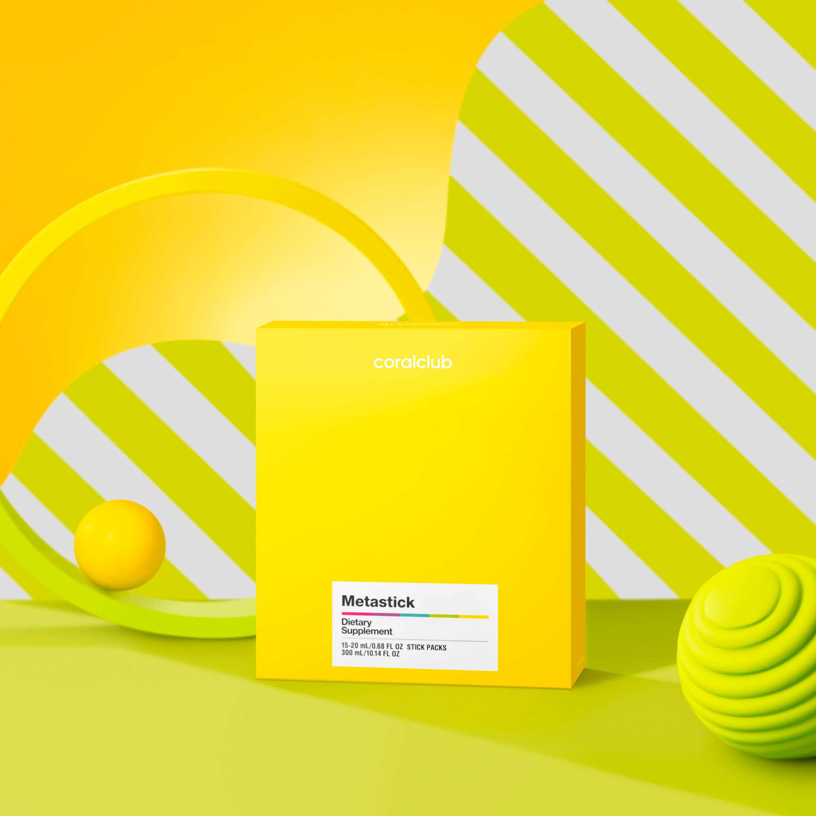
CLUB PRICE
2193 Metastick 15 (20 ML) STICK PACKS
BONUS POINTS
12,0
$21.00
RETAIL PRICE
$26.25

Slide 27
2193 Metastick
4 packages – a one month supply
Bonus Points
46,0
Club Price
$80.00
Market Price
$100.00

Slide 28
Metastick
Your Gut’s New BFF

